Slide 1
Air Traffic Passenger Statistics
By :Ajwad Almajnuni

Slide 2
Data description
This dataset about San Francisco International Airport Report on Monthly Passenger Traffic Statistics . San Francisco International Airport is the largest airport in the San Francisco Bay Area and the second busiest airport in California after Los Angeles Airport. In 2017, it was the seventh busiest airport in the United States and 24th busiest airport in the world by passenger numbers. The data contains 46670 rows and 12 columns .

Slide 3
Goals
The goal of analyzing Air Traffic Passenger Statistics data is because there is a company that wants to present an advertising campaign for a specific product inside the airport, so the data will be analyzed according to the number of passengers to attract the largest possible number for this product.

Slide 4
The tools used for this project
1- Python and Jupyter Notebook
2- Pandas
3- Matplotlib and Seaborn
To write the code
for data manipulation
for plotting visuialization

Slide 5

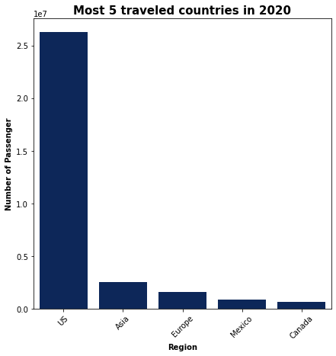
The five most visited countries in 2020

Slide 6
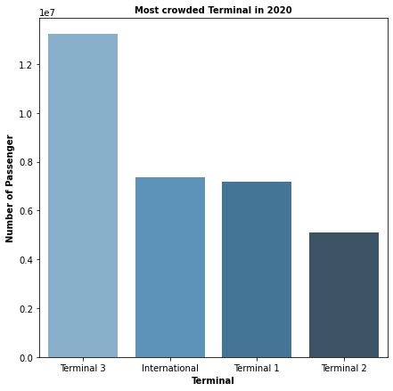
Most crowded Terminal in 2020

Slide 7
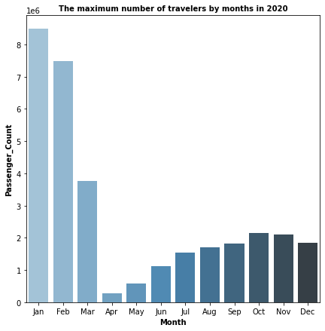
The maximum number of travelers by months in 2020

Slide 8
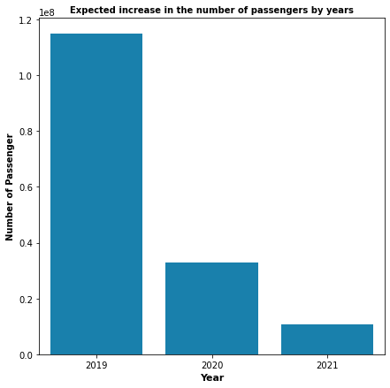
ِِExpected increase in the number of passengers by years

Slide 9
Conclusion
The advertisement will be in English only.
It is better that the announcement be on terminal 3 and it will be during the month of January and February.
it would be better to postpone the announcement until next year.

Slide 10

THANK YOU

